Slide 1
Battle of the Neighborhoods
Where should one Live in London?
N. Joewondo

Slide 2
Background
London welcomed 450,000 people in 2018/2019
Biggest challenge of moving to London:
To find suitable accommodation
London consists of 33 boroughs spanning 1,572 km² in area
Objective:
Cluster boroughs of London based on venues
Visualize the resulting clusters against rental price and crime prevalence

Slide 3
Data
List of boroughs in London
Wikipedia, contains coordinates, population data
Top 500 venues in each borough
via the Foursquare API
Crime statistics by borough (past 24 months)
London Data Store
Average private rent of a 1 bedroom flat by borough
scrape rightmove website using rightmove_webscraper

Slide 4
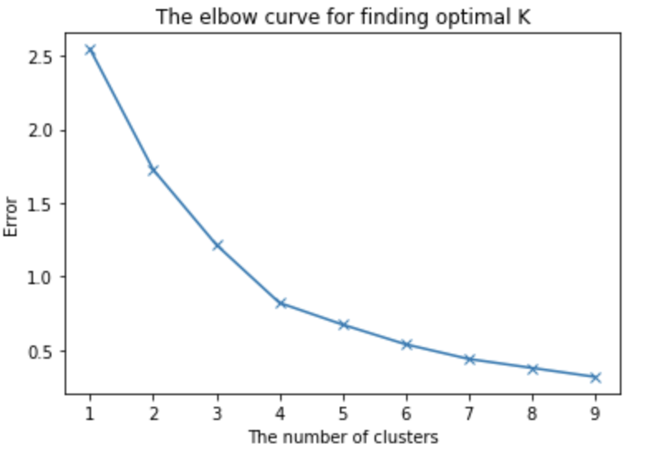

K- means algorithm
Unsupervised ML algorithm
Partition $N$ samples $X$ into$K$disjoint clusters $C$, with centroid $μ_{j}$
Objective:
$\sum_{i=0}^{n}{\min_{μ_{j}εC}{({\left|\left|x_{i}−μ_{j}\right|\right|}^{2})}}$
Optimum number of cluster determined by ”elbow” method
4 cluster is optimum

Slide 5
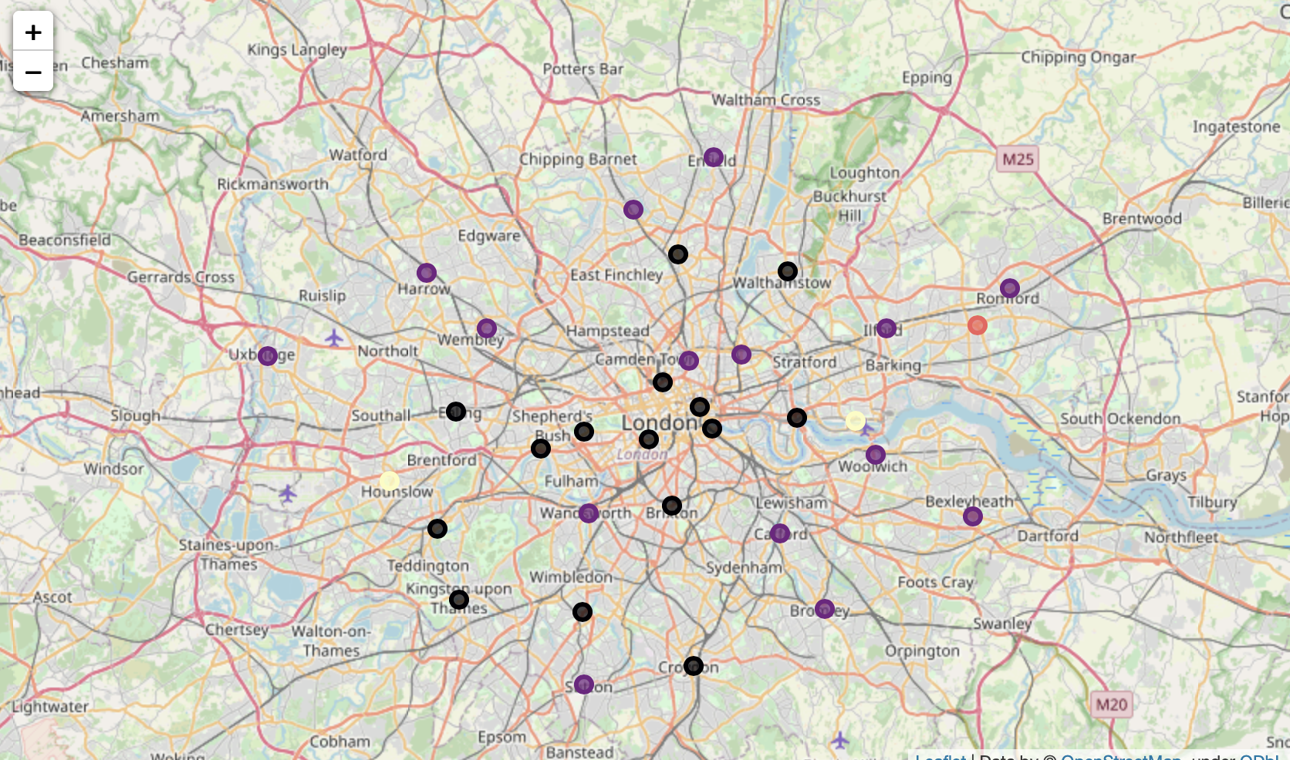
Most common venues in each cluster
Cluster 0: Food, Nightlife
Cluster 1: Food, Shop & Services
Cluster 2: Outdoor & Rec
Cluster 3: Travel & transport (Heathrow & London City Airport)

Slide 6
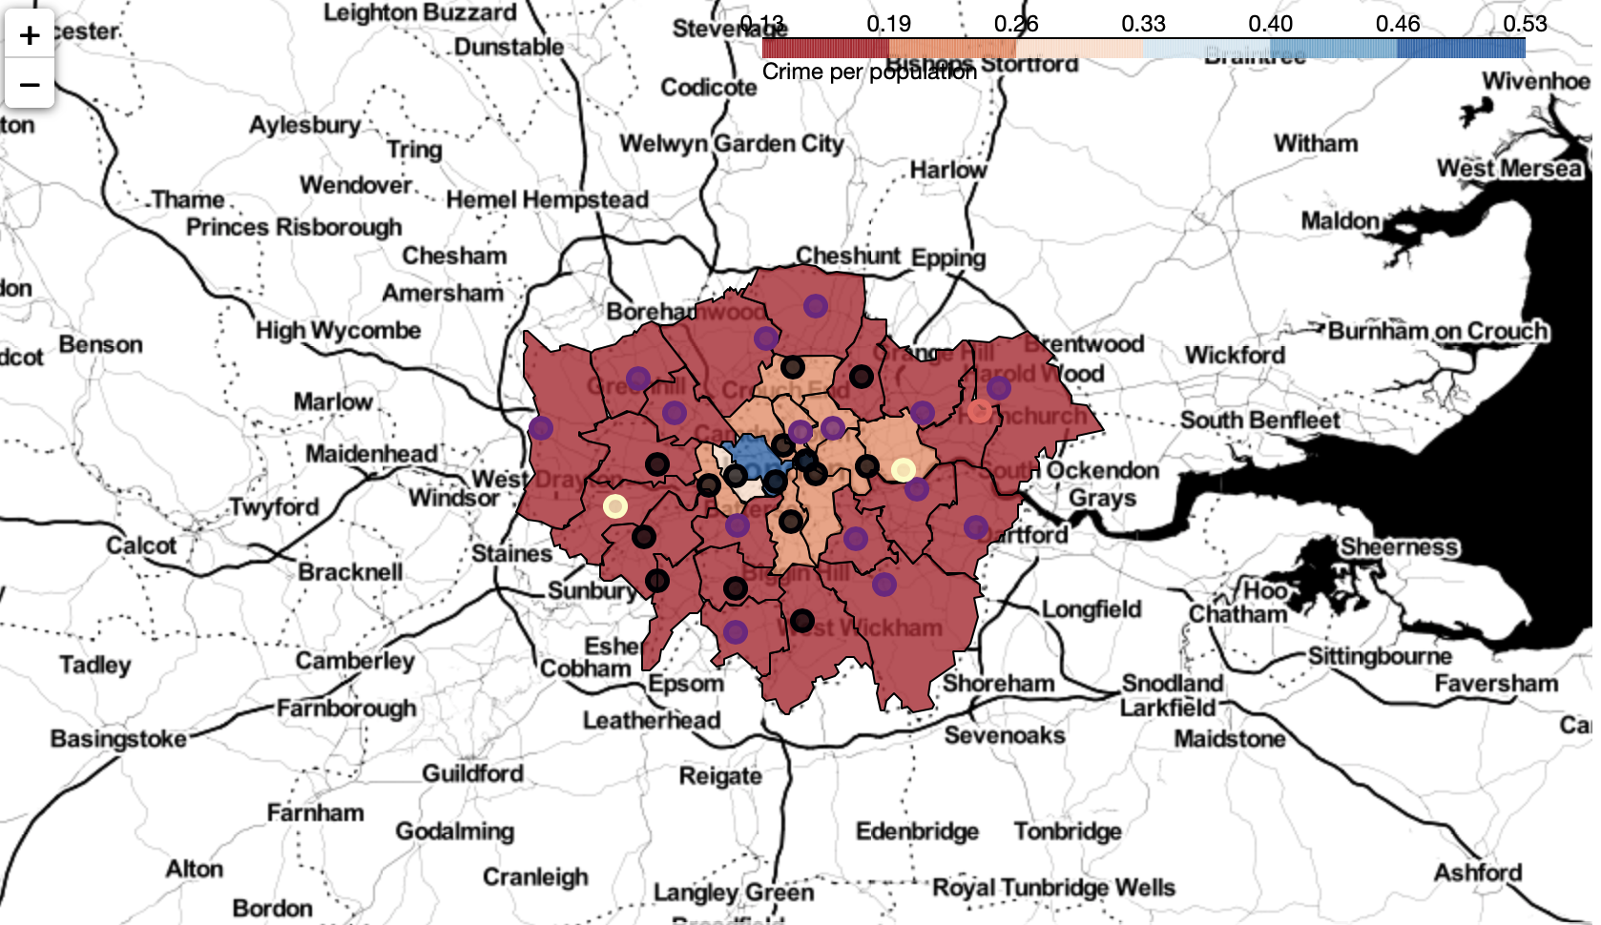
Crime prevalence
All crimes in 2019 – 2020 are grouped by borough, normalized by population
Highest: Westminster
High: Kensington & Chelsea, London City, Camden, Hammersmith & Fulham, Southwark, Hackney, Islington, Newham.
Highly touristic area

Slide 7
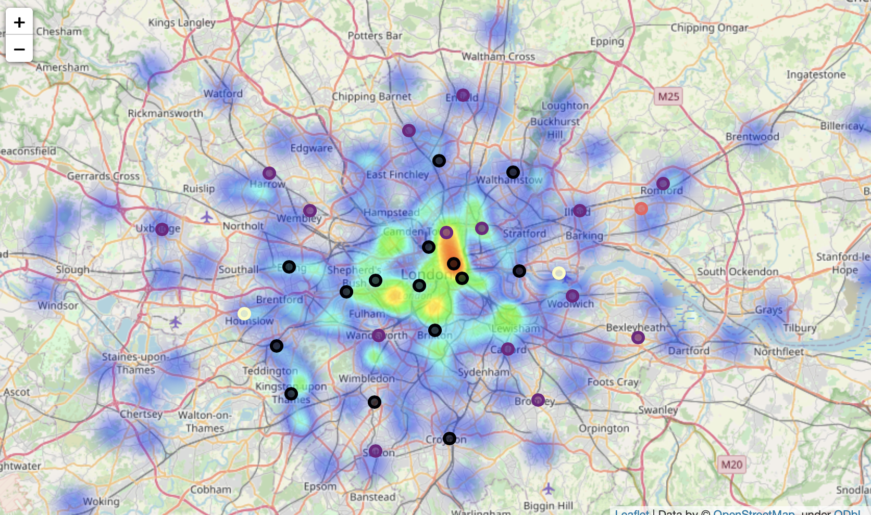
Rental price
heat map shows price of 1 bedroom flat offers on Rightmove
Highest rent : Westminster, Kensington & Chelsea, City of London
TFL travel zone 1

Slide 8
Conclusion
K-means algorithm partitions London into 4 clusters
Cluster 0 for foodie & nightlife focused
Cluster 1 ideal for foodie & shoppers
Cluster 2 for outdoorsy Londoners
Cluster 3 ideal for frequent travelers, due to proximity to airports
Crime prevalence may correlate to tourism (future work recommendation)
Highest crime prevalence in Westminster
High crime prevalence in touristic areas, such as London City, Kensington & Chelsea, Camden, Southwark
Rental price seems to correlate to TFL travel zone
Highest in Westminster, London City, Kensington & Chelsea

